Slide 1
GROUP II MEMBERS. UNIT: BCS 2107- REGULAR CLASS. BSCNRB344123 BSCNRB548222 BSCNRB215023 BSCNRB146224
GITHUB REPOSITORY LINK: https://github.com/BSCNRB344123/DATABASE-GROUP-II

Slide 2


Slide 3


Slide 4
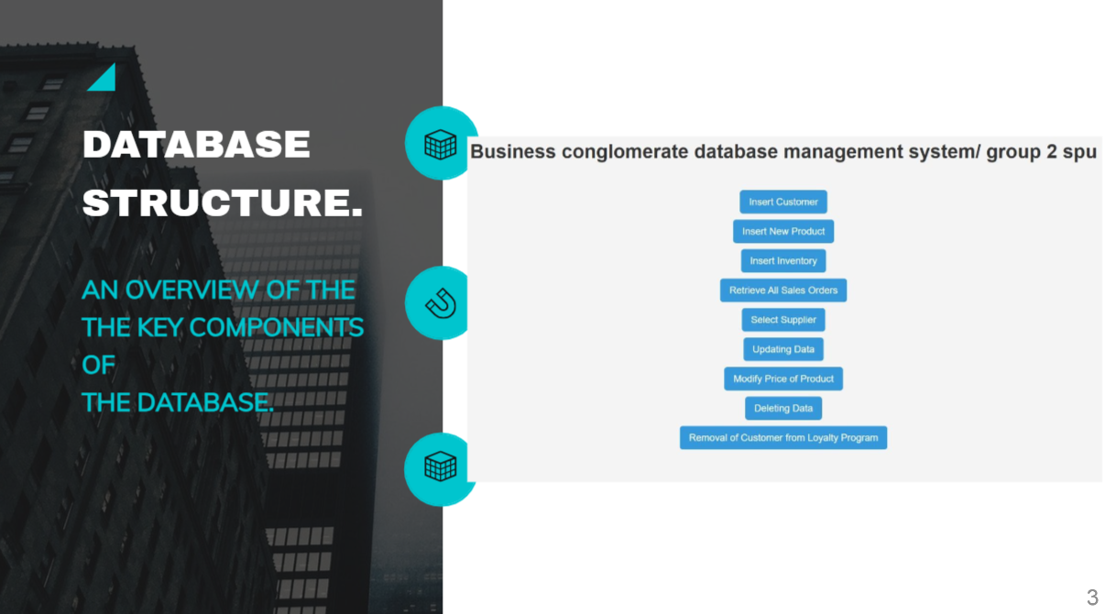

Slide 5
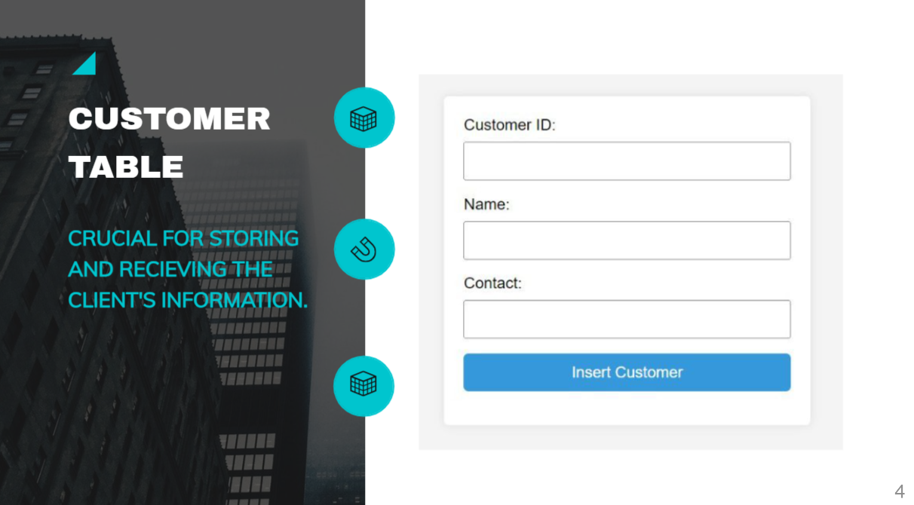

Slide 6
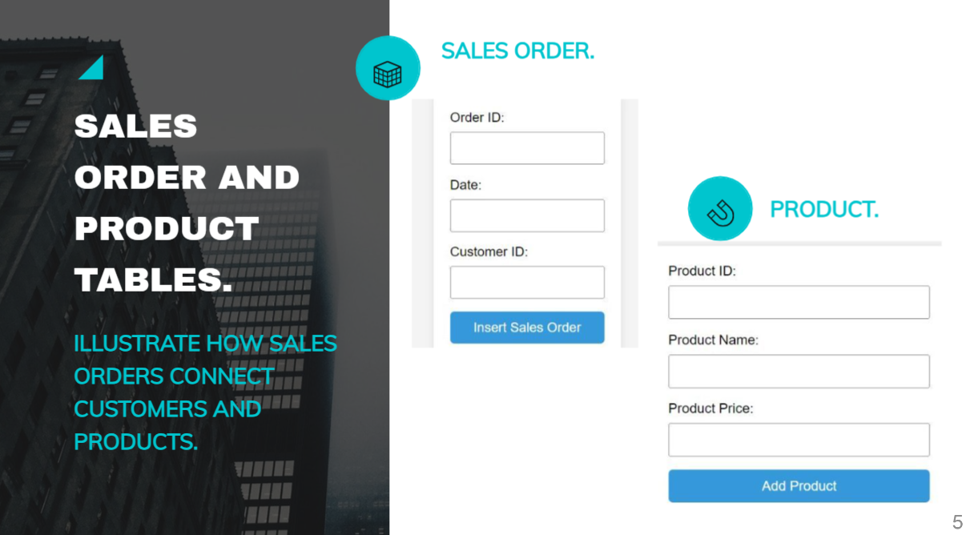

Slide 7
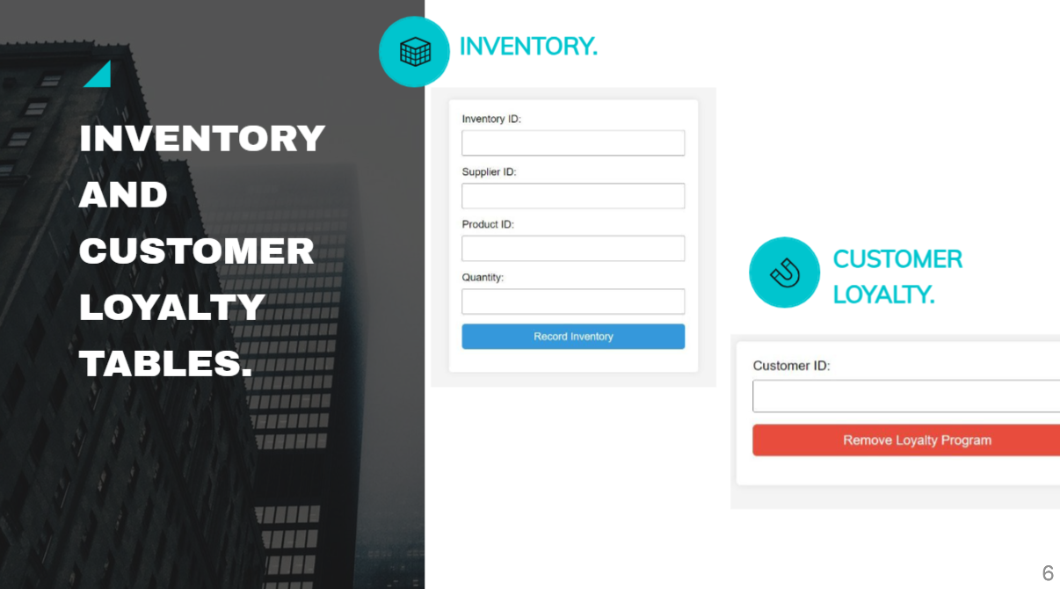

Slide 8
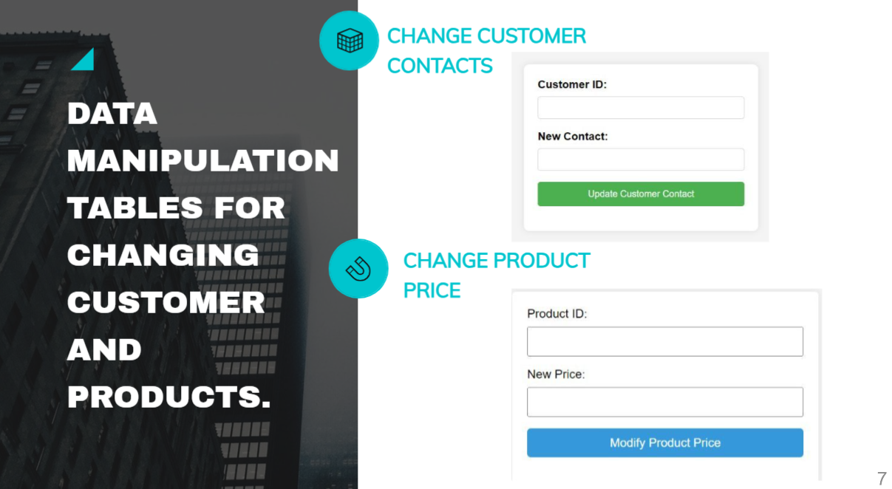

Slide 9


